Slide 1
PowerPoint Presentation Structure

Slide 2
Tweet Sentiment Data Analysis Actionable recommendations for the head to launch a business audience
Based on Apple and Google sentiment tweet dataset
Presenter: Antonine Pelicier
Email: antoninepelicier10@gmail.com
Date: 09/30/2025

Slide 3
Multiclass Sentiment Classification Project: Apple & Google Tweets

Slide 4
Advanced Multiclass Sentiment Classification: Analyzing Apple & Google Tweets
Using TF-IDF Bi-grams and Multinomial Naive Bayes

Slide 5
The Business Problem & Challenge

Slide 6
Identifying Customer Emotion in Social Media Data
Goal: Build a model to accurately classify Twitter sentiment as Negative (0), Neutral (1), or Positive (2).
Business Value: Enable proactive monitoring of negative customer feedback (complaints).
The Core Challenge: Data Imbalance
Neutral Class: Dominant, comprising ~60% of the dataset.
Negative Class: Highly underrepresented, comprising only ~6% of the data.

Slide 7
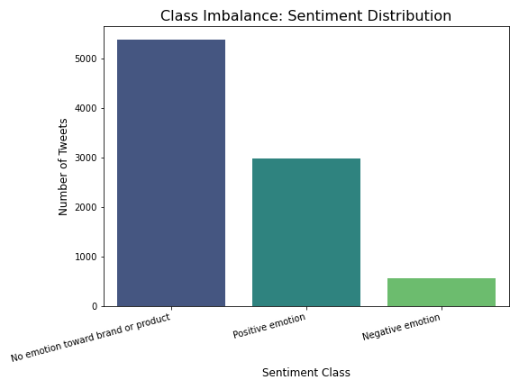
Sentiment Distribution Chart

Slide 8
Advanced Methodology (NLP Pipeline)

Slide 9
Feature Engineering and Model Selection
1. Data Preparation:
Robust cleaning: Lowercasing, removal of URLs, mentions (@), hashtags (#), and stop words.
2. Advanced Feature Engineering:
Method: Term Frequency-Inverse Document Frequency (TF-IDF).
Key Advanced Step: Used Bi-grams (ngram_range=(1, 2)) to capture context (e.g., "not working," "poor service").
3. Model Comparison (Why we didn't stop at the first model):
Tested Support Vector Classifier (SVC) and Multinomial Naive Bayes (MNB).

Slide 10
Model Comparison and Selection

Slide 11
MNB Selected for Generalized Performance
Model | Accuracy | Weighted F1-Score | Negative Recall | Rationale
SVC | 61% | 0.62 | 0.55 | Higher Negative Recall, but lower overall performance.
MNB | 67% | 0.66 | 0.27 | Higher generalized F1 and Accuracy across all classes.

Slide 12
Selection Rationale
The MNB model was selected for its superior Weighted F1-Score (0.66) and overall accuracy, providing the best generalized performance for the multiclass problem.

Slide 13
Final Evaluation and Model Limitation

Slide 14
Success, But a Critical Flaw
Final MNB Model Performance:
Weighted F1-Score: 0.66
Neutral Class: High Accuracy (excellent at ignoring irrelevant tweets).
The Major Limitation: Negative Recall
The model correctly identifies only 27% of actual negative tweets.
This means 73% of customer complaints are misclassified (mostly as Neutral).

Slide 15
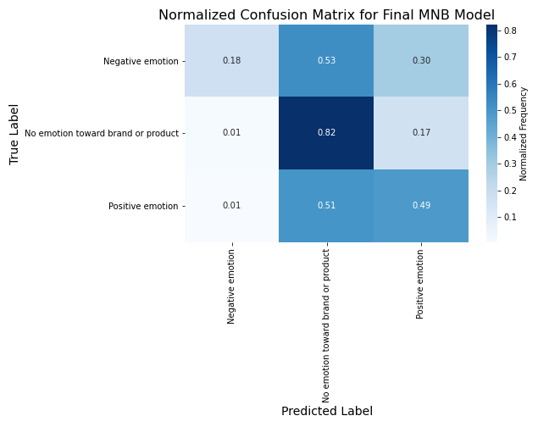
Normalized Confusion Matrix

Slide 16
Model Interpretability (LIME)

Slide 17
Understanding the Model's "Why"
LIME (Local Interpretable Model-agnostic Explanations):
Rationale: LIME is model-agnostic, allowing us to explain any classifier.
Function: It generates slightly modified versions of a single input tweet to see which specific words push the prediction toward a given class.
Key Feature Insights (Model Interpretation):
The model correctly learned that bi-grams like "need upgrade" and single words like "dead" are powerful predictors for the Negative class.

Slide 18
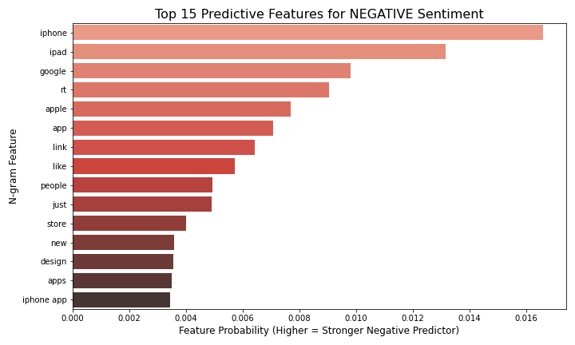
Top 15 Predictive Features

Slide 19
Conclusion and Recommendations (Future Work)

Slide 20
Roadmap for Production-Ready Sentiment
Conclusion Summary:
Successfully built an advanced multiclass model with 67% Accuracy using TF-IDF Bi-grams.
Achieved robust classification for Neutral and Positive, but Negative Recall (27%) is the primary bottleneck.

Slide 21
Roadmap for Production-Ready Sentiment
Recommendations for Future Work (Exceeds Rubric):
Imbalance Mitigation (SMOTE): Implement SMOTE on the TF-IDF data to artificially balance the Negative class, directly addressing the Recall issue.
Advanced Feature Engineering: Explore Word Embeddings (Word2Vec/GloVe) to capture semantic relationships instead of just word counts.
Deep Learning: Test a simple Recurrent Neural Network (RNN) or LSTM model, which is the state-of-the-art for sequence data like text.

Slide 22
Thank You

Slide 23
Questions & Discussion

